Slide 1
TBI Report Out Day A Focus on our Veterans
Virginia Department of Veterans Services
Brandi Jancaitis
Director
Virginia Wounded Warrior Program

Slide 2
Virginia Wounded Warrior Program
Virginia Department of Veterans Services
In response to the growing need to improve and expand services to our nation’s veterans and service members, the Commonwealth of Virginia established the Virginia Wounded Warrior Program (VWWP) in 2008.
Operated by the Virginia Department of Veterans Services in cooperation with the Department of Behavioral Health and Developmental Services and the Department for Aging and Rehabilitative Services.
Notes:
.

Slide 3
VWWP Mission
Virginia Department of Veterans Services
Monitors and coordinates behavioral health, rehabilitative, and supportive services through an integrated, comprehensive, and responsive system of public and private partnerships.

Slide 4
Virginia Department of Veterans Services
VWWP Service Population
The statewide program serves Veterans of any service era, with any military discharge status, and their families.
Any Virginia Veteran in need of behavioral health support
Members of the Virginia National Guard not on active federal service
Virginia residents in the Armed Forces Reserves not on active federal service
Family members of these Veterans and service members

Slide 5
VWWP Traumatic Brain Injury (TBI) Service Numbers
Virginia Department of Veterans Services
FY 14, 12 service requests for TBI services
FY 15, 49 (43 from Southwest Va/Region III) service requests for TBI services
Important caveat – data system is not optimized to capture TBI screening, coming in FY17
In Northern Va/Region II – staff estimate that 20% of total regional cases cope with TBI
Most cases co-occurring with PTSD
Average of 5 veterans per month
Notes:
FY13 – 26 (19 in Region III)
Region II 25 TBI cases - estimates that all of these are co-occurring with PTSD
Percentage of case load estimate - 20%.
Average number of veterans per month, 5 which would include veterans in group.
273,859 Department of Defense Diagnosed TBI Cases Between 2000 and 2012
194,561 mild
42,063 moderate
6,476 have been severe or penetrating
10,210 have not been classifiable

Slide 6
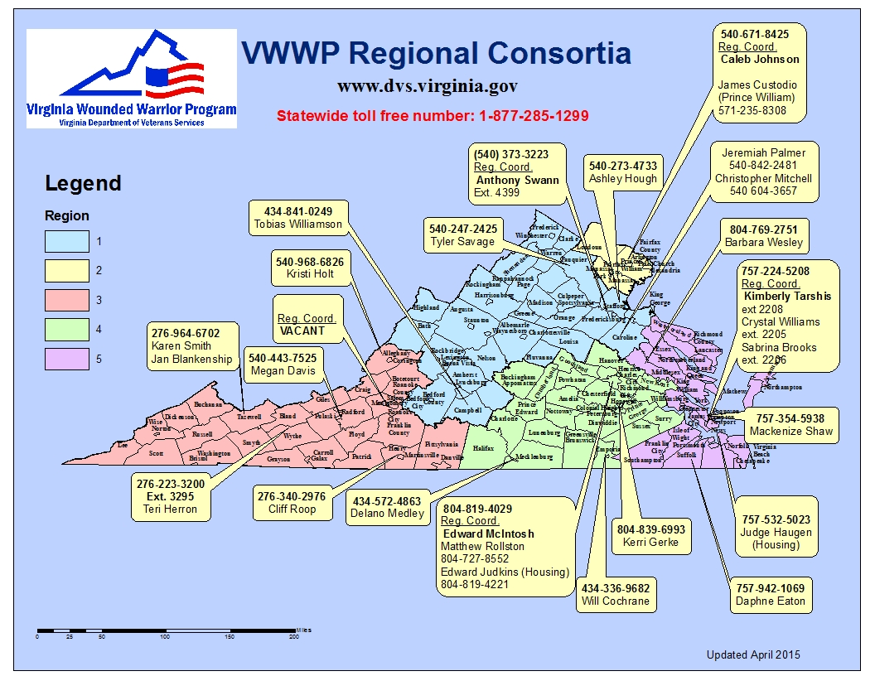
Virginia Department of Veterans Services: Virginia Wounded Warrior Program

Slide 7
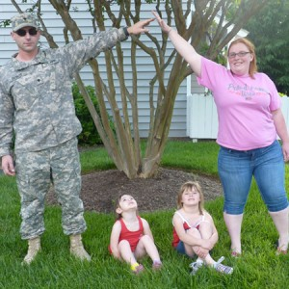
VWWP Services for Veterans Coping with TBI
Virginia Department of Veterans Services
Peer and family support, comprehensive care coordination and referral services to veterans and families
Financial Assistance for TBI services if uninsured
Couples and Family Weekend Retreats
Mission: Healthy Relationships
Mission: Healthy Families

Slide 8
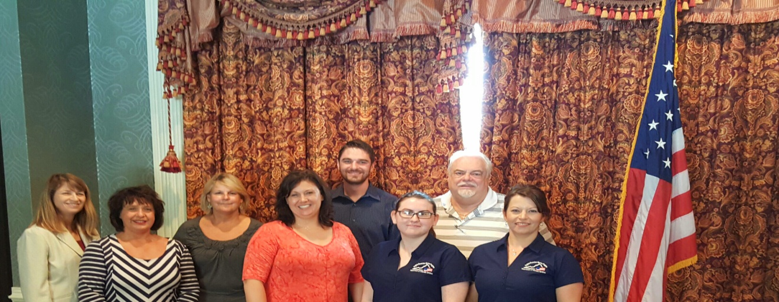
Mission: Healthy Relationships (MHR) Couples Workshop
Virginia Department of Veterans Services
Weekend retreat focused on communication skills and coping with stress
Curriculum adapted from “8 Hours to a Lifetime of Relationship Satisfaction“ © 2009 National Multiple Sclerosis Society
3 couples coping with TBI in most recent workshop.

Slide 9
MHR - Couples Workshop Consumer Quotes
Virginia Department of Veterans Services
“It helps in knowing that we are not alone in our struggles, that there are resources for the caregiver as well. It’s helpful that my spouse recognizes that others like me are having the same issues and it’s not the spouse’s fault or their burden alone to carry”
“It helped my spouse understand the military life and reasons behind my issues, it also gave my spouse and I tools that will assist with a multitude of issues in our relationship – such as encouragement and validating”

Slide 10
VWWP Services cont.
Virginia Department of Veterans Services
Military/Veteran Caregiver Resource Site in partnership with Senior Navigator
http://www.virginianavigator.org/lg/Search/family-caregivers-of-veterans
Coming Soon, Operation Family Caregiver –curriculum led by Caregiver Coach within VWWP (Northern Va, and Hampton Roads) in partnership with the Rosalynn Carter Institute for Caregiving and Riverside Center for Excellence in Aging and Lifelong Health (CEALH)
3 year grant, planning period starts in September 2015

Slide 11
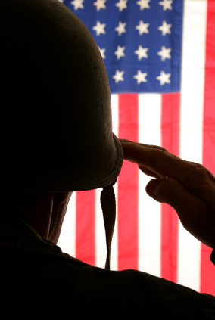
VWWP Regional Services/Partnership Highlights
Virginia Department of Veterans Services

Slide 12
VWWP Northern (Region II) and Brain Injury Services (BIS) Partnership - Veterans Integration Program
Virginia Department of Veterans Services
BIS has worked to make it’s services more accessible to veterans suffering from all levels of BI not only those who might need more intensive services
Services such as Brain Injury Family Intervention will be very useful for veterans
VWWP has partnered with BIS to spread the word about their services
VWWP will assist BIS with care coordination, peer support and referral information for veterans utilizing BIS services
Notes:
BIFI – Brain Injury Family Intervention – education program for family members focuses on family systems and TBI education (developed by VCU)
Do we have BIS service numbers for the last fiscal year BIS reports 8 veterans for last FY

Slide 13
VWWP Region II and the Intrepid Spirit Center National Intrepid Center of Excellence (NICoE) Satellite at Fort Belvoir
Virginia Department of Veterans Services
VWWP providing information presentations to ‘retirement’ classes at Intrepid Spirit
VWWP will provide presentations to Family Member Caregiver Group
DVS Commissioner and Intrepid Spirit Center Director have pledged to work together on getting more veteran accessibility to treatment at the center

Slide 14
VWWP Region III and Brain Injury Services of Southwest Virginia (BISSWVA)
Virginia Department of Veterans Services
BISSWVA is working to develop CLiC for veterans and caregivers coping with TBI
CLiC means: Community Living Connection (CLiC), web-based program launched in 2009
Three key outcomes of CLiC:
A - Strengthen cognitive function including flexibility, memory, problem solving
B - Enhance compensatory strategies – “how do I function with my new normal?”
C - Decrease isolation and loneliness
Notes:
CLiC has served over 95 consumers (total participants- not veteran specific)
Sessions to consumers, with BISSWVA providing the equipment if needed – two or three-hour meeting usually with one or two breaks in the middle, Two Sessions per week
Facilitator – trained individual who oversees Sessions

Slide 15
VWWP Region III and Brain Injury Services of Southwest Virginia (BISSWVA) cont.
Virginia Department of Veterans Services
VWWP Region III hosted a Veterans/Caregiver focus group in coordination with BISSWVA in April 2015 to inform the development of CLiC for Veterans
New River Valley Community Services provided: meeting space, telehealth equipment, IT support
Total of 11 group participants (veterans and caregivers)
BISSWVA has received a Wounded Warrior Project grant (National Nonprofit) to serve veterans with CLiC for Veterans – VWWP will provide referrals

Slide 16
VWWP Region V, Hampton Roads TBI Support Group The Denbigh House, Newport News
Virginia Department of Veterans Services
Group Meeting 1st Thursday of the Month
5 participants: 4 male and 1 female
Prior Service Affiliation: 2 USAF, 1 USN, 3 USA
Mild TBI: 4 participants and Moderate to Severe TBI: 1 participant
All of the participants exhibit short term memory loss, currently live independently with little or no assistance and have strong support systems, 2 of the 5 are able to drive
Notes:
Participant Take Away: Veterans have indicated they enjoy participating in a group where they can share not only their military experience but some of the physical and mental challenges they experience due to their TBIs.

Slide 17
VWWP will be rebranded to Virginia Veteran and Family Support on October 1, 2015
Enhance wellness focus and family unit inclusion
Decrease brand confusion (Wounded Warrior Project, Wounded Warrior Regiments etc.)
How can you help?
Be a Brand Ambassador!
More information at http://www.dvs.virginia.gov/virginia-wounded-warrior-program/

Slide 18
Virginia Department of Veterans Services
Thank you!
Brandi Jancaitis
Director, Virginia Wounded Warrior Program (soon to be Virginia Veteran and Family Support)
Brandi.jancaitis@dvs.virginia.gov
804-371-4675

