Slide 1
Neuropsychiatry in New Hampshire: inpatient and outpatient models
Laura A. Flashman, Ph.D.

Slide 2
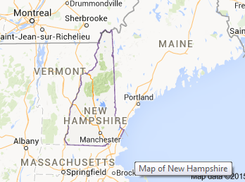

about New Hampshire
Population: 1.327 million (2014)
  New Hampshire is the 42nd most populous state in the USA
Area: 9,351 square miles
  New Hampshire is the 46th largest state in the USA
Major Industries - textiles, lumber, tourism, electronic equipment, software
State Nickname - Granite State
State Motto - "Live Free or Die"

Slide 3
Facts about New Hampshire
NH
US
 | Persons under 5 years, percent, 2013 | 5.0% | 6.3%
 | Persons under 18 years, percent, 2013 | 20.5% | 23.3%
 | Persons 65 years and over, percent, 2013 | 15.4% | 14.1%
 | Female persons, percent, 2013 | 50.6% | 50.8%
 | White alone, percent, 2013 (a) | 94.2% | 77.7%
 | Black or African American alone, percent, 2013 (a) | 1.5% | 13.2%
 | American Indian and Alaska Native alone, percent, 2013 (a) | 0.3% | 1.2%
 | Asian alone, percent, 2013 (a) | 2.4% | 5.3%
 | Native Hawaiian and Other Pacific Islander alone, percent, 2013 (a) | Z | 0.2%
 | Two or More Races, percent, 2013 | 1.6% | 2.4%
 | Hispanic or Latino, percent, 2013 (b) | 3.2% | 17.1%
 | White alone, not Hispanic or Latino, percent, 2013 | 91.6% | 62.6%
Population: 1.327 million (2014)

Slide 4
Overview of talk
The health care system in NH (briefly)
The inpatient model
  Successes
  Challenges
The outpatient model
  Successes
  Challenges
Future directions/Sustainability

Slide 5
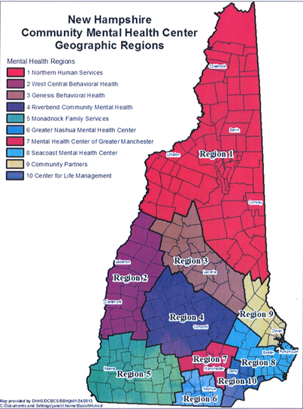

Slide 6
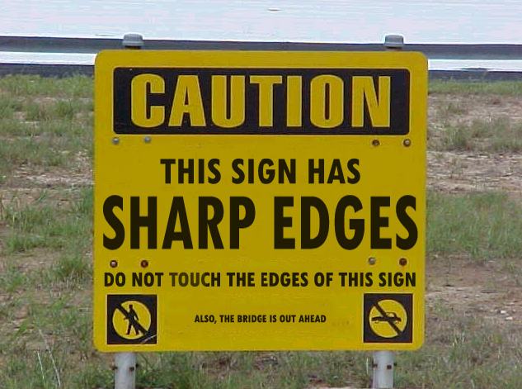
The Big Picture

Slide 7
The Inpatient Model: 1992-2009
New Hampshire Hospital

Slide 8
Why a Neuropsychiatric unit?
At least 10% of the population of the US suffers from a significant neurological disorder.
20-30% of these individuals also suffer from a severe psychiatric disorder.
The Neuropsychiatry Intensive Care Unit (NICU) at New Hampshire Hospital opened in 1992 in response to the needs of the many NH citizens who came to the state psychiatric hospital with complex neuropsychiatric disorders.

Slide 9
ThE NICU
A 12 bed unit, which consistently ran at full census, with a waiting list of individuals referred from the community.
Served selected individuals with psychiatric disorders that are made more complex by other brain (neurological) disorders, who have failed to benefit from traditional interventions.
The focus of the treatment process was on the changes in mood, personality, emotions, behavior, and cognition that result from the underlying injury or destruction of brain tissue.

Slide 10
Individuals Served
The neurological conditions commonly seen include:
traumatic brain injury
developmental disability
cerebrovascular disease
epilepsy
degenerative disorders
infections of the nervous system
neurological impairments resulting from substance abuse
brain tumors
genetic or congenital disorders with residual mental/behavioral manifestations

Slide 11
Individuals served
Adults,18 years of age and older
Referrals: planned voluntary or voluntary-by- guardian admissions
Originated from area agencies and mental health centers, or from within the hospital
A discharge plan must be provided

Slide 12
Individuals Served
Target problems are cognitive, affective, and behavioral disturbances – the neurobehavioral sequelae – that can result from psychiatric and neurological disease.
Manifestations include:
Impulse control difficulties
Episodic or continuous self-abuse or self-injury
Mood disorders, apathy, or social withdrawal associated with neurological and psychiatric impairment
Psychotic syndromes
Cognitive and/or functional decline

Slide 13
The Treating team
Neuropsychiatrist (and Neuropsychiatry Fellow)
Neuropsychologist (and Neuropsychology Fellow)
Neurologist
Psychologist/Behavior Analyst
Nurses
Social Worker
Recreation Therapist(s)
Case Manager
Internal Medicine Physician
Community Team
Family
Referrals as needed (dentist, MRI)

Slide 14
Role of the team
Consultations with area agencies, community mental health centers, general hospitals and private providers.
Diagnostic and evaluation work-ups.
Brief, goal-oriented, inpatient trials of pharmacological and other interventions (behavioral, environmental, etc).
Long-term treatment planning in close collaboration with primary caregivers and community care systems for patients’ treatment, and care in the community.
  Providing housing, respite care, day programming, rehabilitation and long-term treatment and management will be the responsibility of primary caregivers and community care systems.

Slide 15
Target: Neurobehavioral Cluster of TBI (NBC/TBI)
PREMISE: TBI can cause a variety of lingering and disabling sequelae. Problems with independence and mobility may be the most apparent to an observer, but not necessarily the most challenging.
What often underlies the challenges in return to work, school and major role are problems in:
  cognition (including memory and judgment)
  impulse control
  modulation of affect
  regulation of mood
These areas are often referred to as the neurobehavioral cluster of challenging behaviors.

Slide 16
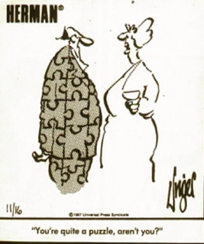
What are “Challenging Behaviors”?
Behaviors that keep people from successfully participating in the community, in hospital activities, in groups
What does it mean to y’all?
  Yelling
  Hitting
  Perseverative questions
  …

Slide 17
Case example: JAY
28 year old, single, right handed male
11 years of special education
Neuro: Down’s syndrome and moderate intellectual disability
  Developmental milestones (speech, learning, walking, toileting) delayed
Psych: Psychotic Disorder NOS?, Mood Disorder NOS?
  increase in oppositional and defiant behaviors
Prior treatments:
  “hugging” or ignoring
  Pharmacological interventions

Slide 18
Case example: JAY
7th child
Lives in home with parents (mother is legal guardian)
Services:
  Home aides
  Day programming
  Supported employment (feeding animals on farm, cleaning stables, worked at recycling plant)
Challenging behaviors:
  Refuses to get ready to leave house in morning
  Refused to get out of car to return to home in evening
  Yelling, swearing, throwing things in public places during day program
  Property Damage

Slide 19
Case example: JAY
Cognitive Profile:
  Slowed gross motor skills
  Engaged in repetitive behaviors – “high-fiving” the examiner
  Dysarthric speech of limited quantity
  Impaired language comprehension
  Dementia Rating Scale: 62/144 Severely Impaired, all domains
  Token Test: 21/44 Severely Impaired
  Boston Naming Test: 32/60 Severely Impaired
  PPVT: Estimated IQ = 58 Mildly-moderately Impaired

Slide 20
Case example: JAY
Medications:
  Depakote 1750 mg
  Topamax 100 mg
  Risperdal 0.5mg
  Celexa 40 mg
  Conazepam 1 mg
  Ambien 10 mg
  Levothyroxine 100 mg
  Lorazepam PRN
  Acetaminophen 650 mg q 6 hrs PRN
  Ibuprofen 400 mg q 6 hrs PRN

Slide 21
Questions
Does he need to be on so many medications? Are the medications working?
What can we do to keep him more active in the community?
Why challenging behaviors?
  What causes them?
  What happens as a result of them?
Environmental/personnel contributions?
Cognitive contributions?

Slide 22
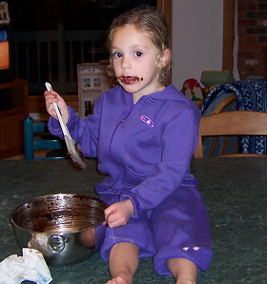
Ways to Deal with
Challenging Behaviors
Medications
Behavioral Programs
Cognitive Remediation Strategies
Every admission starts with comprehensive evaluation

Slide 23
ThE gOOD NEWS: ALL BEHAVIOR
SERVES A PURPOSE
We do not want to just extinguish a behavior that is being used as a form of communication
Must give an appropriate alternative
Key: In order to change a behavior we must be able to provide an appropriate replacement behavior with which an individual can obtain desired consequence
Notes:
Ie—Lisa and her icon cards—instead of hitting, show card that she’s mad.
Instead of trashing the work space when client became flooded/overwhelmed, teach them to ask verbally or non-verbally using a sign or hand gesture to indicate that he needs a break, then can come back to it when ready.

Slide 24
Challenges may be related to personality changes:
Decreased social and self awareness
  Decreased boundaries
  Intrusive
  Sexually inappropriate
  No “filter” on their thoughts/conversations
  Not picking up on social cues
  Irritability
  Mood swings
  Decreased frustration tolerance
  Decreased ability to delay gratification
Notes:
Decreased sphere of awareness
Inappropriate social skills lead to social isolation and problems with behaviors at school, future employment, community living, maintaining friendships/relationships, family distress, divorce

Slide 25
Challenges may be related to cognitive changes:
Poor judgment = decreased ability to anticipate consequences of their actions
Decreased cognitive flexibility
Impulsivity
Inaccurate self-monitoring, poor sense of difficulties and their impact on every day functioning
Difficulty in attention and concentration—ability to filter out sensory information
Receptive and expressive language difficulties
Notes:
Decreased ability to anticipate consequences of their actions—a lot of variability in how far out a person can anticipate consequences, both in tasks and socially
The people with poor judgment, awareness, and impulsivity are at very high risk for accidents, injury or costly mistakes and need someone around to help compensate for those deficits.
Is anyone familiar with the Allen Cognitive Disabilities model—leather lacing test, etc..? -quick description for those not… I love the overall model—BUT…folks with brain injury may score high on the ACLS-5, but have such profound deficits in areas like impulse control or severe short term memory deficits that they need much more supervision than they would if you only scored the ACLS-5 NEVER PERFORM A STANDARDIZED EVALUATION IN A VACUUM—GET FUNCTIONAL DATA TO ESTABLISH A PATTERN OF BEST FX’L PERFORMANCE!!
I’ve had clients score as being able to live on their own on ACLS-5, but d/t emotional dyscontrol or impulsive actions, needed 24 hr supervision b/c they were at so high risk of self-harm or harming others (suicide, jail, etc.)

Slide 26
Challenges related to “Deficit Syndromes”
Apathy
Isolation
Withdrawal
Low motivation
Notes:
Different than depression.
Tough to get going, but once they’re at an activity, brighten up, engage and have fun.
And it’s not that they’re not trying hard enough…there are structural and chemical differences that can help cause these Sx—and, many times behavioural approaches can help improve functional outcomes—we’ll talk about this a more later.

Slide 27
Approach to Dyscontrol Syndromes
Consider if due to:
  Depression
  Mania
  Psychosis
  Anxiety
  Environmental factors
If so, treat accordingly

Slide 28
Search for Other Causes
Some of the most dramatic results we have obtained were from treatment of:
  UTIs
  Other infections
  Sinusitis
  Abscessed tooth
  Aspiration pneumonia (swallowing problems)
  Nicotine withdrawal

Slide 29
Medication Management
Community doctors frequently increase dosage or add another medication to treat disruptive symptoms
Medication side effects can cause other symptoms
Fear of removing medications in community
Taper in safe environment, one drug at a time
MEDICATION MANTRA: Start low, go slow, stop sooner

Slide 30
Medication Management
THERE ARE NO “MAGIC BULLETS”
Often, medication alone will not be enough
Judicious use of medications that make a difference, in combination with cognitive modifications and support plans, result in most favorable outcomes
This does require work/ongoing process

Slide 31
Use of support Protocols
(Behavior Plans)
Goals:
Increase or decrease a behavior
Improve quality of a behavior
Stop an old behavior
Teach a new behavior
Choose wisely (i.e., cannot always make a behavior “go away” and can’t fix everything – what will most improve the individual’s QOL)
Notes:
ABA is some people’s life work. Years on it. Intro courses can easily last a week
Not going to leave here being able to design a program, but you will be more familiar with the structure, language and intent of programs
Help you work more effectively with your behavioural specialist in the community, and better implement and tweak behaviour programs with your client or loved one.

Slide 32
Six Steps for a Solid
Applied Behavioral Analysis
Identify Target Behaviors
Measure the Behavior
Analyze the Behavior – A B C’s
Develop an Intervention
Program Generalization of the Behavior
Empirically Evaluate the Results

Slide 33
Potential Target Behaviors
Aggressive/ assaultive behavior
Throwing/kicking/punching/breaking objects
Sexually inappropriate behaviors or statements
Boundary Problems
Loud outbursts/verbal aggression
Crying episodes
Perseverative statements
Refusing to cooperate with requests
Frequency of self injurious behavior
Psychotic statements
The list goes on and on….
Notes:
DON’T TALK TOO MUCH HERE…MORE EXAMPLES COMING UP

Slide 34
The ABCs of ABA
Functional Assessment: Starts with a Baseline Period – a specified time period when the frequency, duration, or intensity of the target behavior is tracked prior to the implementation of an intervention
Antecedent: the stimulus or situation to which the individual is responding
Behavior: the behavior (target behavior) we see exhibited by the individual
Consequence: the stimulus or stimuli that the individual receives, or that s/he is stopped being subjected to, as a result of the behavior
Notes:
BLOW RIGHT THROUGH THIS SLIDE
Next slide shows some examples

Slide 35

ABCs of ABA
Antecedents:
A request
A refusal
Someone coming/going
Physical discomfort (e.g. hunger)
…
The Behavior
Consequences:
Gets attention
Calms down
Gets removed from situation
Put in time out (again, removed from situation)
…
“self-injurious behavior”

Slide 36
Functions of Some Behaviors
(Or, why do people do stuff?)
Obtaining desired objects, events, people and activities.
Avoiding objects, events, people and activities.
Communicating frustration, anxiety, pain, feeling overwhelmed.
Notes:
KEEP MOVING…DON’T GET BOGGED DOWN WITH TOO MANY EXAMPLES
The WHY are the doing it…
Obtaining--want something like CD’s (guy used to threaten and make mother buy him stuff or throw huge tantrum in store→Mom bought him stuff), want favorite staff to come see them, want Dunkin’ Donuts
Avoid having to touch something that sets their sensory systems on edge, avoid work/school, avoid less preferred staff by intimidating them, avoid therapy session
Communicating an emotion/sensation---when a client yells “I don’t understand!!” because expectations were too high, or a cue or task given was too complex.

Slide 37
Behavior Plans/Support Protocols
Provides a formalized plan=increased consistency of approach: if person does “X”, we will do “Y”
Aimed at developing or strengthening adaptive behaviors and attitudes
Part of an effective treatment plan aimed at enhancing adaptive skills and behavior
Leads to increased independence for the individual
Notes:
If they do “x”, we will do “Y”
Good for client but can also be a big anxiety reducer for the staff, b/c now they know what to do.=increased CONSISTENCY (key word)

Slide 38
Most Important Factor in Success of an ABA Program
CONSISTENCY
    Across Staff
    Across Shifts
    Across Environments
Notes:
Consistency of implementing the behaviour program, AND RECORDING DATA
Re-enforcement schedule—intermittent variable—most re-enforcing, someone on one shift doesn’t follow program, depending on the client, can mess up the whole program.
That occasional, almost random re-enforcement is VERY tough to extinguish.
Anyone that has had children knows this…taking 5 y.o. Bobby to the grocery store. He knows he won’t get candy, but now and again he asks…Then one day you are having the day from hell…you’re exhausted, and he’s tired and whiny, and yovelling for a candy bar…give it, then you are going to experience a HUGE increase in the intensity and frequency of that behaviour for the next month while you try to extinguish or minimize it again…

Slide 39
Potential strategies
Chosen on individual basis: EXAMPLES

Slide 40
Behavioral strategies
Goal: Reducing difficult behaviors while encouraging more appropriate behaviors
Differential reinforcement of other behaviors (DRO): reinforcement for not engaging in the target for a specified interval of time (i.e., reading not hitting)

Slide 41
Behavioral Strategies
Differential reinforcement of alternative behaviors (DRA): reinforcement of behaviors which serve as alternative behaviors to the difficult behavior (i.e., count to 10)
Differential reinforcement of incompatible behaviors (DRI): reinforcement of behaviors which are incompatible with difficult behaviors (i.e., can’t be done simultaneously)
Beware: Spikes in behavior (“extinction burst”)
  Give impression that behavior has worsened
  Typically followed by rapid decline in behavior

Slide 42
DID YOU HEAR SOMETHING?
Planned Ignoring or Extinction
A technique whereby no attention is given to an inappropriate behavior; will lose saliency
But remember: behavior may get worse before it gets better
Intermittent schedules hardest to extinguish, and variable harder than fixed schedules
  Harder to distinguish intermittent schedule from extinction

Slide 43
Behavior Plan: BC
Challenging Behavior: sitting and refusing to move
Reaction: planned ignoring, walk away
Reinforcement: would receive positive praise/high five for standing back up
Other Intervention: psychoeducation with mother
Note: Be careful of REINFORCING undesirable behavior with attention
Notes:
spikes

Slide 44
NOPE-CAN’T DO THAT, HEY!
IS THAT ELVIS?!?
Redirection and Distraction
Redirection: a procedure whereby an individual who exhibits an inappropriate behavior is prompted to engage in a more appropriate alternative behavior
Distraction: The person is provided something else to attend to
Notes:
Also lovingly known at my house as, “shiny object…” used on some of my more intense family members when they perseverate on negative subjects. My husband also regularly uses it on me…
Offer them an alternative choice
If you take away a behaviour, you must given them something else to do—what is the purpose of the behaviour?
Includes: go find something to do! They can’t—structure them as needed, provided choices

Slide 45
Behavior Plan: RT
Challenging behavior: continuously shaking hands, then grabbing people and at times assaulting them.
Alternative offered: Give thumbs up without touching—with continuous rote learning
Reinforcement: copious praise, social attention
Other intervention: training of staff to avoid inadvertently increasing the behavior—tickling, dancing, shaking hands
Notes:
KEEP ON MOVING!!!!!

Slide 46
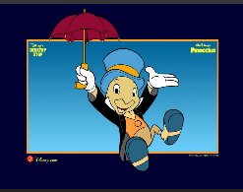
BE THE FRONTAL LOBES—EXPRESS YOUR INNER JIMINY CRICKET
Explicit problem solving or
emotional reasoning assistance
Caregiver verbalizes the cognitive/emotional process the individual would use if they had the capacity
If they have a lot of executive function deficits, you’re going to be the one to tell them
  when to start and stop something…
  when they’ve had enough of something—food or glitter glue.
  Explicit problem solving when they run into a task based problem or social interaction difficulty—if repeated enough over a long enough period of time, many people are able to internalize the script and use it with fewer or no cues
Notes:
If they have a lot of executive function deficits, you’re going to be the one to tell them
when to start and stop something…
when they’ve had enough of something—food or glitter glue..
But especially helpful is explicit problem solving when they run into a task based problem or social interaction difficulty—if repeated enough over a long enough period of time, many people are able to internalize the script and use it with fewer or no cues

Slide 47
Example: Misreading Social Events
Challenging behavior: Highly Irritable client is going to “blow up” at a peer walking by they think has snubbed them.
Reaction: Caregiver witness verbalizes what actually happened, offers alternatives to her irritable behavior, then provides distraction if needed.
Notes:
I’m sure she didn’t see you—she likes you a lot and would’ve said ‘Hi’ if she saw you. Definitely worth keeping your cool—nice job. I know you’re in a hurry to get to your hair appointment, so we can see her afterwards for a chat or maybe coffee.”
Also—Lisa losing at Bingo

Slide 48
UH HUH…YEAH…WHAT?
Talk the talk, but can’t walk the walk
Be aware of differences between expressive and receptive abilities
Fantastic vocabulary (often a “loop”) makes caregivers think an individual is much higher functioning cognitively than she/he really is—leading to unrealistic expectations, mistakes, conflict
Notes:
I am a huge fan of neuropsych testing—a good OT can help id difficulties in this functional area provide recs, but Neuropsych can really parse out the finer areas of strength and difficulties—can be especially helpful in this domain of function.

Slide 49
Behavioral Approach: Adjust Expectations--HB
Challenging behavior: Awesome vocabulary, wins word jumble games but was never ready for work—forgets—led to massive verbal outbursts and physical attacks.
Reaction: Caregivers adjust expectations, provide adequate structure, reminders. Check understanding of what was said-have her repeat back her understanding.
Other intervention: Intensive structure and cued with tact to preserve her dignity.

Slide 50
The doctor (nurse/staff) is in…
Planned Conflict Management
A designated time to channel questions, grievances, and reinforce skills with specific staff

Slide 51
Behavior Plan: JM
Challenging Behavior: Constant, bitter complaining to staff about almost everything she perceived/ experienced: her interactions with people, lack of items, wanting different items, perseverative concerns about past injustices.
Reaction: Scheduled meeting times at top and bottom of hour to discuss concerns/requests/problem solve x 5 minutes, with one longer session at start of shift x15 minutes. Eventually faded to 1x/hr and less. Session with psychologist once/week supportive therapy.
Reinforcement: Venting/discussions with staff provided only at scheduled times unless true emergency—much praise given for engaging in alternative behaviors—groups, self-care, etc.

Slide 52
GET THE PENDULUM SWINGING
Behavioral Momentum
A procedure in which before asking the person to do something she is unlikely to do, you first ask her to do a simple low-demand task she is likely to do and build in task demand in a step wise fashion.

Slide 53
TORN BETWEEN TWO… OPTIONS
Forced Choice
Procedure offering client two choices, both of which result in a positive/desired outcome—provides client some control
Notes:
On a personal note—how do you react when someone gives you an ultimatum?
Recent study proved what we know at an intuitive level, but often don’t practice, that when people as young as two years old are provided a choice between even two things, they are far more likely to make a choice and comply with the request.

Slide 54
Forced Choice
Behavioral Challenge: engaging apathetic or oppositional client in an activity/task.
Reaction: Offer two choices, either of which have positive outcomes (i.e.—Gym or Grocery Shoppin?)
Reinforcement: Praise for choosing an activity
Notes:
Talk about try it—you’ll like it—if you hate it you can always come back to the unit in ten minutes

Slide 55
Token Economies
Provides a TANGIBLE marker of progress
Can use VISUAL cues (calendar, graph, chart in room) or VERBAL cues (praise, time reminders) depending on individual
Effective with cognitively compromised individuals
Reinforcement interval can range from minutes to days
  Useful for moving from a schedule where the individual is rewarded after each appropriate response to a schedule where several appropriate responses must be made
Good for building the ability to delay gratification, extending an individual’s attention span
Notes:
EXAMPLE ON NEXT SLIDE
One type of behaviour program…

Slide 56
Token Economy: PD
Challenging Behaviors: Perseveration, boundary issues
Tokens: Checkmarks
Reinforcement Interval: 1 hour
Desired Behavior: Differential Reinforcement of Other Behavior (DRO) = responding to cues to cease the challenging behavior in 3 or fewer cues
Target: 75% of available tokens
Reward: Desired activity (1:1 time, trips off unit)
Notes:
Reinforcement Interval: 1 hour (this can be varied based on level of functioning)→this was increased to 2 hours once he got the idea, so it wasn’t so demanding on staff
Talk about that if you choose to use a behaviour program, you would also use other model/frames of reference as appropriate
Sensory Integration techniques to help get this fellow at an optimal level of alertness-cat on a hot tin roof skittery; self-regulation
Behavioural frame of reference-techniques included—shaping-he had to wait to get attn; 1 minute, work 2 minutes, work 3 minutes, then 5 then 7…
Cognitive Behavioural Therapy—looking at cognitive distortions—all or nothing thinking, catastrophizing, future telling
Educational Framework-social skills training, vocational training
Dialectical Behavioural Therapy-based on CBT—includes distress tolerance
Motivational Interviewing—also has roots in CBT—helps people look at their ambivalence about changing their behaviour, and helps empower them towards changing it
LEARN ABOUT AS MANY FRAMES OF REFERENCE AS IS FEASIBLE—ENRICHES YOUR PRACTICE—EVEN IF YOU ARE A “PHYSICAL DISABILITY” OT/PT/RN…we’re all human and we all wrestle with our thoughts and ambivalence—the more skilled you are, the more likely you are to be able to help your clients

Slide 57
Evaluation of the Results: A Work in Progress
Meet the person where s/he is cognitively
Evaluate, evaluate, evaluate—look at the data! Tweak, tweak, tweak (for example: Increase reinforcement intervals)
Feedback from those implementing plan and the individual whose plan it is
Have we decreased undesirable behaviors? Have we increased desirable behaviors, or replaced undesirable behaviors with more acceptable behaviors?
HOW MUCH less frequently, intensely?
Can the individual apply these behaviors, strategies in more than one situation?

Slide 58
What Are the Steps?
Most effective treatments result from a careful appraisal of:
Careful medical evaluation
  Repeat as needed
Careful appraisal of environmental factors
  Applied behavioral analysis
  Neuropsychological evaluation
  Occupational evaluation
  Identify individual’s high preference activities/desires
  Current medical condition(s)
Careful appraisal of other disorders
  Depression -- PTSD
  Mania -- Psychosis
  Anxiety -- Seizures
Single agent medication trials

Slide 59
ADVAntages: Inpatient model
Time to do medication trials/build appropriate behavioral plan (average length of stay = 8 weeks)
Safety measures in place
Immediate access to professions to evaluate patient and develop plan
Well-trained staff who are able to consistently implement behavior plan and tolerate extinction burst
Education helps community team readjust expectations and become advocates again

Slide 60
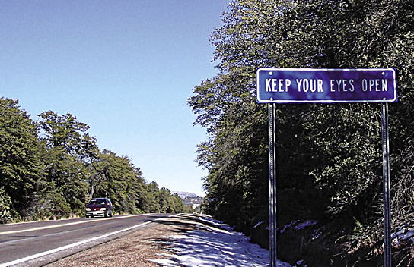

Slide 61
Challenges: Inpatient model
“Honeymoon” period
Collapse of discharge plan/appropriate community placements
Difficulty implementing hospital structure and well trained staff into multiple community settings
Frequent staff turnover in community
Long lengths of stay can undo community strategies (range of LOS = 1 week – 24 months)

Slide 62
Challenges: Inpatient model
Consistency
Diversity of community resources depending upon region
Philosophical differences
Funding

Slide 63
The Outpatient model
Interagency teams (cMHC and area Agencies)

Slide 64
A collaborative effort of:
NH Division of Developmental Services
NH Division of Behavioral Health
Brain Injury Association of NH
Dartmouth Medical School
Funded by a 3 year HRSA Implementation Grant
Mission:
To improve New Hampshire’s capacity to assist people with the neurobehavioral consequences of TBI

Slide 65
PROJECT GOALS
Build infrastructure:
1. To enhance level of provider expertise in the community in the evaluation and management of NBC/TBI, and to improve access to providers
2. To enhance capacity of survivors and family members to self manage NBC/TBI

Slide 66
METHODS
  Broaden scope of NBC/TBI expertise in NH
  - Build on existing state-level and local interagency teams
  - Build on and link available community support services
  - Facilitate access to services through care coordination

Slide 67
EXISTING PROGRAMS IN NH
Statewide Mobile Dual Diagnosis Team (Us)
Local Mental Health/Developmental Services Interagency Teams
Other Organizations & Support Systems
  National Alliance for Mentally Ill NH (NAMI NH)
  Family Support through DS System
  Parent to Parent of NH
  ServiceLink
  Children’s Care Management Collaborative

Slide 68
STATEWIDE TEAM
Neuropsychiatrist
Neuropsychologist
Behavioral Specialist
Project Coordinator
Developed training materials
Worked with “interagency team” from CMHC/AA

Slide 69
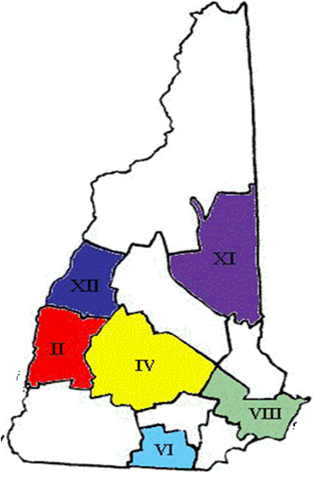
PILOT SITES: Local Mental Health/Developmental Services Interagency Teams
  City Region
  Nashua VI
  Portsmouth VIII
  Concord IV
  Conway XI
  Lebanon/
  Hanover XII
  Claremont/
  Newport II

Slide 70
Goal of the Program: Broaden Scope of Local Interagency Teams
Education:
-Local Planning Retreats
  Sample of Pilot Site Training:
  Neurobehavioral Consequences of TBI
  How to Modify Treatment When Your Client has Neuropsychological Deficits
- Other educational trainings, conferences
Consultations and Mentoring:
  Role modeling of team collaboration
  3 consultations in each pilot site, with responsibility for consultation moving over time from state team to local team
  Quarterly mentoring meetings
  Discipline-specific peer supervision

Slide 71
Goal: Enhance Capacity of Local Providers, survivors and family
Local team identifies Key Service Providers and support groups
Local Provider/Support Organization Conference
Enhance Resources: website, annual BIANH conference
Just in Time Learning

Slide 72
Enhanced Resources and Education: BIANH Conference
Local Provider/Support Network Conferences (6 regions, with 80-100+ attendees)
2 consecutive BIANH annual conferences: Neurobehavioral Track w/ 100+ attendance
Sample of topics:
  Cognitive Sequelae: Assessment and Implications
  Neuropsychiatric Aspects of TBI Across the Lifespan: Children, Adults, and Older Adults
  Psychopharmacological Issues in the Management of Neurobehavioral Sequelae of TBI
  The Basics of Behavioral Interventions: Weaving Behavioral Momentum Into Everyday Life

Slide 73
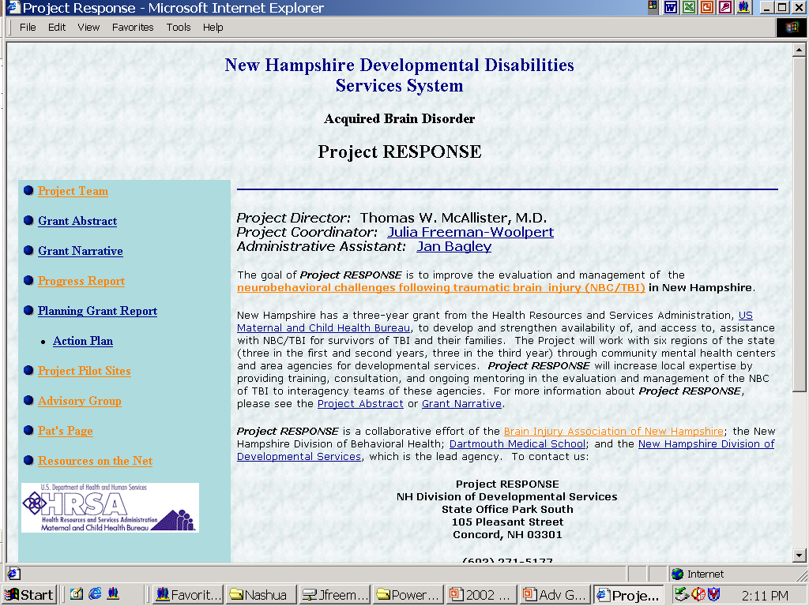
WEBSITE: http://nhdds.org/programs/tbi/response/

Slide 74
Develop Capacity for Care Coordination/SuSTAINABILITY
Care coordination training in each pilot site with goal of implementation of statewide care coordination system
Regional/local experts reduce need for access to state team
Planning/budgeting with DDS, DBH for ongoing state neurobehavioral team for consultation, training, mentoring

Slide 75
Just in Time Learning
(the “hands on” part)
Monthly visits to each team
Case presentation
  Review of records (consultation form completed prior to meeting)
  Discussion with team
  Interview with individual/family
  Recommendations/discussion
  Formal report
  Follow up and tweaking
  Gradual shift of “power” to local team

Slide 76
Differences in our inpatient vs. outpatient approach
Inpatient: primary focus: Make the individual better
Outpatient: primary focus (in part due to grant mission): Provide education and build community resources – Make the system better
  Individual clients serve as the conduit and benefit, but not primary focus

Slide 77
Evaluation of program
Outcome and Evaluation Plan:
  Checklist: Did we do what we said we would?
  Activity-Specific Evaluations/feedback
  Post-project survey of survivors, family/caregivers, teams/providers
  2 Focus Groups: Teams, and Survivors/Families

Slide 78
Impact of Project Response
Local Conferences
Notes:
Interagency Team Functioning
Interagency Team Expertise in TBI
Clinical Care/Improved Services
More Clients with TBI Identified
Follow up with provider, support groups from Local Conference

Slide 80
Focus Group Methodology
Two Groups: (1) Providers and (2) Individuals and Caregivers
Videotaped 1.5 hour group discussion
  Facilitated by professional facilitator unrelated to the project
  Verbatim transcripts made and reviewed along with videotape
“Immersion and Crystallization”
  Team reviewed videotapes and transcripts in day long retreat
  Independently developed recurrent themes
  Achieved consensus on themes
Independently reviewed transcripts and assigned relevant statements to one or more of the agreed upon categories
  Consensus conference to achieve final assignment

Slide 81
Provider Focus Group: Recurrent themes
  Collaboration (mentioned 30 times)
    Need for multi-disciplinary team approach
    Within the interagency teams
    With the State Team
    With family/caregivers
  Empowerment (mentioned 27 times)
    New knowledge/skills, application of old skills
      Confidence that they can become resources/experts
    We already have skills that can be applied
    Don’t have to start from scratch
    Don’t have to learn neuropsychiatry
  Training (mentioned 26 times)
    A little is good, more is better, need for ongoing
  Awareness (mentioned 16 times)
    Clients with TBI, links to psychopathology

Slide 82
SummarY: Training
It helped
But it didn’t help enough:
  Need for ongoing training
  Need for state-wide resource team
    Constant staff turnover
    Updating, continuing medical education
    Requires ongoing resources, effort, commitment
All levels of providers need training
  “Train the trainers” model insufficient
Although directed at providers:
    Individuals with TBI and families are the best teachers
    Providers can be role models

Slide 83
Successes: Outpatient
  Changed the mindset of those working with individuals with TBI
    Behavior is not purposeful, manipulative
    Decreased anger and frustration
    “thinking out of the box”
  Increased knowledge and interest in many providers working with individuals with TBI – members of community team did feel more like “experts”
  Regular visits to regional teams allowed for follow up and “tweaking” of plans/ recommendations

Slide 84
Challenges: Outpatient
  Ongoing need for state resources
    While teams felt they learned an enormous amount, they did not feel ready to serve as the “experts” without backup at the state level
    Staff turnover on local teams was and will no doubt continue to be a frequent occurrence, and resulted in unevenly trained teams with a need for ongoing support.

Slide 85
OUTPATIENT CHALLENGES
More training for front-line staff
  Trickle-down training does not always work
  Constant turn-over of front-line staff necessitates ongoing training
Flexibility in consultation process
  Intimidating group
  Use of video interviews or videotaping
  Alternate interviewer or formats
  Eligibility criteria
Participation of injured individuals & families
  Absolutely critical

Slide 86
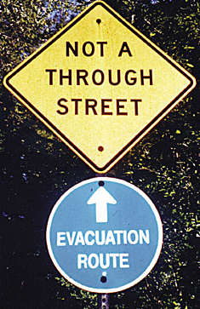

Slide 87
Challenges to long-term sustainability
Financing
  State deficit led to DHHS requiring $2M decrease in funding at State Hospital
  Unit was precipitously closed
  Statewide Mobile Dual Diagnosis Team funding not carried forward
Staff Turnover
  Loss of expertise at local level due to high staff turnover
  Limited psychiatric expertise in neuropsychiatry
  Reallocation of unit resources to help cover short staffing within hospital
Lack of Resources in Community

Slide 88
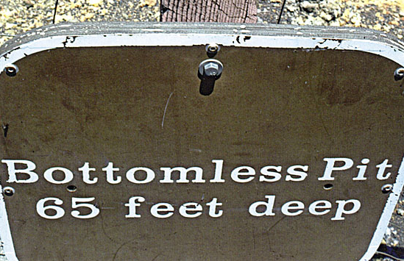

Slide 89
But the fight goes on…
Community partners (Area Agencies, Providers’ Council, BIANH) continue to advocate for both inpatient option and outpatient mobile team
Informal consultation continues to occur
Other hospitals/rehab placements considering development of a NICU
Model has been state funded for mobile team for those with intellectual or developmental disability and challenging behaviors, with good success

