Slide 1

Building Capacity in Virginia Schools: VDOE Update 2015
Deborah M. Johnson, Ed. S.
Virginia Department of Education
Office of Special Education Instructional Services

Slide 2

TBI Trainings

Slide 3
TBI Team Trainings
Summer -3 Day Training
Follow-up training the following spring
Cohort 5, trained in June 2015

Slide 4
30 TBI school/regional teams across the Commonwealth
Hanover County
Region II Collaborative (Newport News, York, Williamsburg-James City, Chesapeake, Virginia Beach, Suffolk)
Stafford County
Fairfax County (4 Teams)
Shenandoah Valley Regional Program (Harrisonburg City and Page County)
Amherst/Lynchburg
Halifax
Prince George
Norfolk
Portsmouth
Gloucester
Wise
Arlington County
Rockingham County
Region VI Collaborative (Roanoke City, Alleghany, Danville City, Covington, Franklin County, Patrick County and Henry County)
Frederick County
Greensville County
Loudoun County
Montgomery County
Northwest Regional Education
Region II Collaborative (Newport News, Poquoson, Hampton)
Roanoke County
Orange County
Richmond City
Staunton City
Fauquier County
Franklin City Public Schools

Slide 5
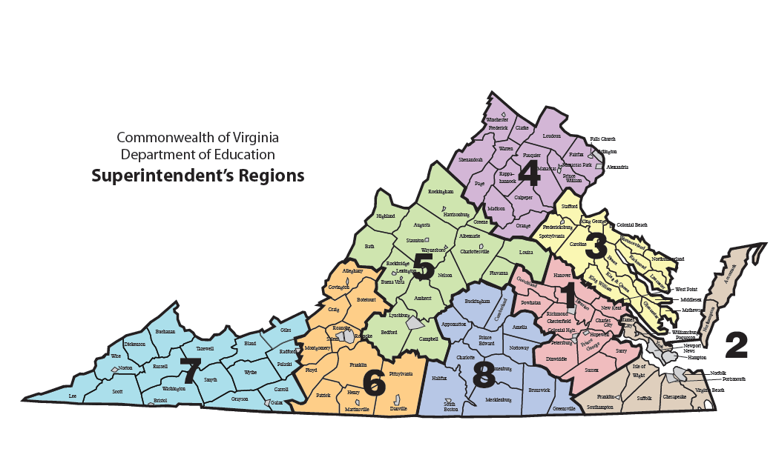

Slide 6
TBI Trainings have also included:
Representatives from VDOE Training and Technical Assistance Centers (TTAC)
  Have a great deal of experience in working with teams of educators, related service providers, and administrators
  Have access to technology that can help teams communicate effectively from distances

Slide 7
TBI Trainings have also included:
Our “Lifelines” from:
  BIAV
  BIS
  BIS SW
  Crossroads to Brain Injury Recovery
  University of Virginia
  Children’s Hospital of the King’s Daughter, Norfolk
  Children’s Hospital of Richmond
Comprised of specialists from around the Commonwealth who work with students with TBI and their families every day
Volunteering to provide information to teams as needed

Slide 8
These TBI teams have
provided professional development/academy courses
provided trainings for
  SLP OT/PT and behavioral specialists
  school nurses
  school administrators and school board members
  special ed and general ed teachers
  P.E. Teachers and athletic trainers
  school psychologists/social workers
  parents and students

Slide 9
These teams have
provided webinars for OT/PT/Psych/SW
met with local tv channels to share info
formed work groups to determine procedures to best support TBI students
provided trainings for administrators/TBI team members on concussions
provided resources for TBI postings on school websites, libraries and in parent resource centers

Slide 10
These teams have
made presentations to detention centers, and private schools, stakeholders and at conferences
established data tracking systems
built collaborative networks within their communities
improved communication amongst key leaders within school divisions
developed a Memorandum of Agreement with
local hospital
reviewed division policies and
procedures

Slide 11
Other VDOE sponsored
TBI trainings/presentations
July 8-9-TTAC and Lifeline representatives presented on TBI to the Shining Stars Early Childhood conference.
October 6, 2014- school psychologists trained
August 2014 -educators, admin, school psychologist, and school social workers from Gloucester County trained
November 5, 2012-school psychologists from Northern Virginia trained, Dr. Peter Patrick, presenter
October 1, 2012 -educators from Loudoun County trained
September 15, 2012 -school psychologists trained, Dr. Peter Patrick, presenter

Slide 12
Don’t forget emails!
VDOE/Partnership for People with Disabilities sends Articles, notice of online trainings, research findings to over 600 educators
Over 600 educators send emails to countless other educators in their schools/regions
=
Many, many people with TBI resources!

Slide 13
Concussion

Slide 14
Definition
A concussion is “a traumatic brain injury and is defined by the 4th International Conference on Concussion in Sports (2012) as a complex pathophysiological process affecting the brain and induced by biomechanical forces”.
(Virginia Board of Education Guidelines for Policies on Concussions in Student-Athletes (2015))

Slide 15
The TBI Continuum
Mild
Moderate
Severe
}
}
}
Traumatic Brain Injury
{
Concussion

Slide 16
Concussion Guidelines
Due to Senate Bill 652, (2010), and House Bills 410 and 1096, and Senate Bill 172 (2014) (Student-Athlete Protection Act) ,the Code of Virginia was amended directing the Board of Education to develop and distribute to school divisions by July 1, 2015:
  guidelines for policies dealing with concussions in student-athletes
  requiring each school division to develop policies and procedures regarding the identification and handling of suspected concussions in student-athletes.
(Virginia Board of Education Guidelines for Policies on Concussions in Student-Athletes, 2015)

Slide 17
Concussion Guidelines
On January 13, 2011 Virginia Board of Education Guidelines for Policies on Concussions in Student-Athletes were adopted by the Board of Education.
  Included Return to Play guidelines for policies and procedures
On January 22, 2015 Virginia Board of Education Guidelines for Policies on Concussions in Student-Athletes were adopted by the Board of Education.
  The original guidelines were amended with Return to Learn guidelines for policies and procedures with emphasis on Return to Learn before Return to Play.

Slide 18

Concussion Guidelines
These guidelines suggested that “consideration should also be given to addressing the academic needs and gradual reintroduction of cognitive demands for all students who have been determined to have a concussion.”
(Virginia Board of Education Guidelines for Policies on Concussions in Student-Athletes, 2015)

Slide 19
Next steps…continue
building capacity by training teams
increasing awareness of TBI in schools and university coursework
promoting concussion policy
improving identification of students with TBI
sharing resources
building collaborative networks between schools and hospitals/brain injury services

Slide 20
Resources
Virginia Dept. of Education
  http://www.doe.virginia.gov/special_ed/disabilities/traumatic_brain_injury/index.shtml
  http://www.doe.virginia.gov/boe/guidance/health/2015_guidelines_concussions_in_student_athletes.pdf
TTAC Online:
  http://ttaconline.org/disability-related-information

