Slide 1
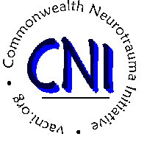
Access to Neurobehavioral Services in the Commonwealth of Virginia
Cara Meixner, Ph.D. and Cynthia O’Donoghue, Ph.D.
James Madison University
Brain Injury Report Out Day
July 24, 2015
This work is supported through funding from the Commonwealth Neurotrauma Initiative Trust Fund, Virginia Department of Rehabilitative Services. Permission to cite information from this presentation must be granted by the investigators.

Slide 2
Why?
A 24-year old living with family attends a clubhouse program during the week. She exhibits escalating agitation, aggressiveness, and apathy now manifesting in “yelling” and an inability to be consoled.
A 45-year old who sustained a frontal lobe injury has completed an inpatient rehabilitation program but continues to exhibit impulsivity and memory loss with intermittent spells of depression.
A 32-year old with severe neurobehavioral issues has been accepted and discharged from four nursing homes based on unmanageable behaviors. He has nowhere to go, but is a risk to self and others.

Slide 3
Challenge and Opportunity
Individuals with brain injury often struggle with challenging behaviors that can be addressed with the proper treatment and supports.
Access to appropriate neurobehavioral services has been consistently identified as a priority issue in Virginia for many years.
The CNI Trust Fund has requested a report on the scope of the problem and need in Virginia; description of available resources; identification of service gaps; and recommendations for service development, policy decisions, and funding.
Notes:
This call is derived from the RFP from CNI.

Slide 4

Today’s Talking Points
Provide general overview of purpose and scope;
Preview major findings and significant issues in Virginia;
Describe other states’ approaches;
Present potential avenues and opportunities.

Slide 5
Purpose and Scope
What are the neurobehavioral (NB) issues, treatment, and services in the Commonwealth? What NB models and interventions are promising?
What is the extent of the need for NB services in VA?
Where are current needs being met? What is available?
How are services paid for with public and private funds?
What is the number and nature of Virginians who receive services out of state?
What policies are recommended to improve access to care for Virginians?
What recommendations address current and future funding needs for a continuum of care approach?

Slide 6
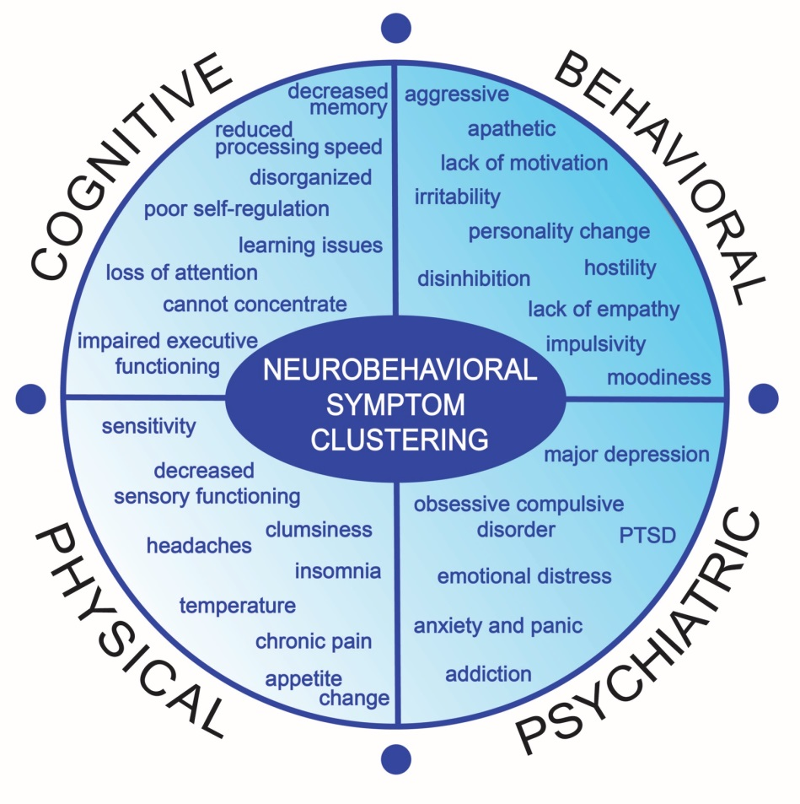
Defining Neurobehavioral (NB)
Neurobehavioral refers to the way the brain affects emotion, behavior, or learning.
Needs and issues refer to the compromising cognitive, behavioral, physical, and/or social changes that result from an ABI.
© P. O’Donoghue et al. (2015)
Sources: Wood, 2001; Zasler, Martelli, & Jacobs, 2013; Baddley, 1986; Evans, 2001; deGuise et al., 2008.
Notes:
Reminder: NB definitions correlate with disciplinary emphasis. Our attempt is a more global working definition.
The term “neurobehavioral” and the notion of “neurobehavioral issues or deficits” carry many definitions – or no definition at all. NB, writ large, is how the BRAIN affects emotion, behavior, or learning. When one has an ABI, she or he has greater NB needs than that of the general population – as there are compromises to cognition, behavior, physical abilities, and socialization. These “SHOW UP” or appear to us as personality differences, trouble making decisions, impulsivity, lack of motivation, and so forth.
Further, these NB issues persist, which leads to worsening of abilities. We see clients who are under or un-employed, or who are at risk of institutionalization. The important thing to note is that without intervention, especially early intervention, signs and symptoms usually intensify and severely inhibit quality of life for persons with ABI.
Person may experience personality changes, find problem solving difficult, experience a lack of motivation, and/or act impulsively.
Persistent issues often stem from compromised functional abilities limiting engagement in professional, social, and educational activities, leading to:
Underemployment
Institutionalization (e.g., judicial, medical)
Need for financial assistance

Slide 7
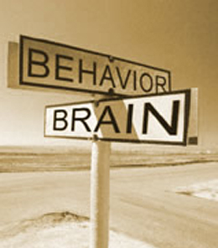
NB Treatment and Services
Continuum of care for individuals that recognizes:
  Recovery is not linear
  Diagnoses are multi-complex and co-occurring
  Services may change over time
Education, prevention, crisis management and stabilization, transition to rehabilitation, and reintegration into society
Interdisciplinary and multi-agency

Slide 8

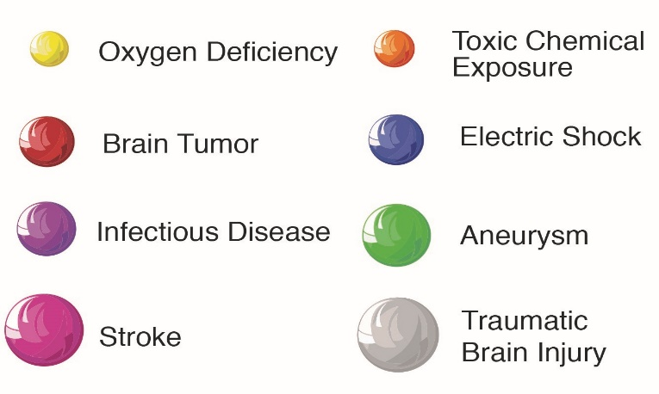
Brain Injury in Virginia
Our estimates are based on ER, hospital, and mortality statistics; empirical literature; and the 2014 Census figures for VA.
  Virginians (18-65) living with TBI: 106,000
  Virginians (18-65) living with Stroke: 148,400
Figure 1. Common causes of brain injury. Graphic designed for this project by Christopher Katalinas. ©

Slide 9
Informing NB Care in Virginia
?

Slide 10
Informing NB Care in Virginia
Survey Findings
Demographics
190 providers; 44% response rate (n=84)
51% offer services specific to neurobehavioral, serving an average of 160 cases annually

Slide 11

Informing NB Care in Virginia
Survey Findings
Eligibility
74% must have at least an ABI diagnosis from client; others may include mental health, substance abuse, etc.
Image from Teens and TBI: www.huffingtonpost.com
Funding
35% indicated “no payment information considered” whereas all other responses were some combination of Medicaid, Medicare, private funding, private insurance, or other.

Slide 12
Informing NB Care in Virginia
Needs pertaining to respondents’ organizations:
Funding mechanisms (4.38)
Supported living programs (4.17)
Community-integrated homes (3.86)
Intensive residential treatment (3.81)
Behavioral supports (3.75)
Neuropsychological and behavioral management (3.67)
Perceived needs pertaining to other organizations:
Funding mechanisms (4.53)
Supported living programs (4.33)
Community-based services (4.31)
Community-integrated homes (4.19)
Neuropsychological and behavioral management (4.14)
Interagency Collab (4.14)

Slide 13
Informing NB Care in Virginia
Qualitative 3-Case Analysis
In most instances, a singular course of action was identified, though many respondents idealized an interdisciplinary, coordinated, and/or team-centric approach.
Focus was paid to the notion of reviewing and adjusting medications. This was seconded by behavioral modification.
Trends:
  Gap between how respondents would realistically versus idealistically deal with neurobehavioral cases.
  Strong adherence to a medical, pharmacologically centric model stressing short-term stabilization versus a continuum of interdisciplinary care and trans-agency supports.

Slide 14
Informing NB Care in Virginia
FOIA (Freedom of Information Act) Data
In-state nursing facility care: number of persons served (n=1,057; 2014) has increased 394% over three years.
Out-of-state care: 54-66 served annually (2010-2014)
  Higher acuity patients
  Varying mortality rates (up to 15%, 2010)
  4 times the cost, per day.

Slide 15
Informing NB Care in Virginia
In a nutshell, there are two core needs:
$
and a continuum of care
Interdisciplinary Multi-Agency Triage
Crisis Stabilization – Transitional or Residential Living – Supportive Living

Slide 16
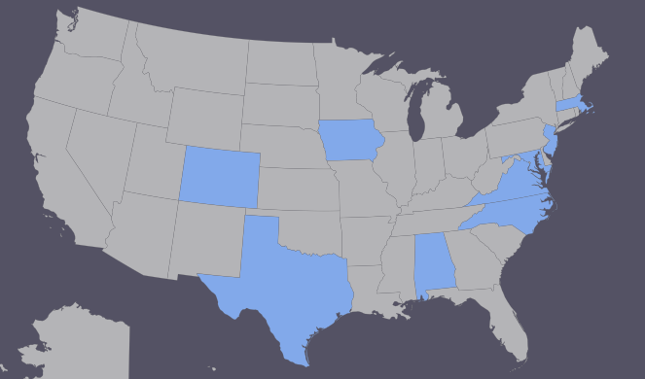
Model Initiatives
Colorado
Front-end HCBS Waiver, focus on supportive ($220/day) and transitional living ($350-450/day)
Iowa
HCBS Waiver, but long wait list ($2,800/month)
Exception to Policy (ETP) for NB
Maryland
Focus on high-level neurobehavioral clients; no waiver cap
5 providers with some bundled services
Massachusetts
HCBS Waiver, with Kindred-Stoughton (locked) for severe NB cases – up to $195K year or $500+ day for residential habilitation
Texas
No waiver; extraordinary support from General Assembly (26M) ©
Notes:
Services and resources range (“spectrum” – CO, “continuum” – MA and IA, and “high risk” – MD);
Waiver programs, while complicated to manage, enable access to community-based and residential services;
Trust fund dollars can be creatively sourced (e.g., AL, NJ, TX) and leveraged;
Good providers can be hard to find, expensive to keep;
Small-scale change happens through collaborative networks and “fierce” advocacy;
Large-scale change follows crises (e.g., class-action lawsuits) and political appointments.

Slide 17
Avenues and Opportunities
Interdisciplinary Triage
Intensive Crisis Stabilization (ST and LT)
Transitional and Supportive Living
Interdisciplinary Multi-Agency Triage
Crisis Stabilization – Transitional or Residential Living – Supportive Living

Slide 18
Avenues and Opportunities
Interdisciplinary Triage
  Risk Assessment
  CONCEPT (MPAI, acuity)
  Cross-agency collaboration
Intensive Crisis Stabilization
  Pilot
  Exception to Policy (ETP)
Transitional and Supportive Living (Step-Down)
  Preventative care
  Pro bono or pilot
  Waiver
    Redesign of ID/DD
    Options:
      HCBS, Demonstration, Managed Care
      Habilitation v. non-habilitation
      Diagnostic v. universal
Interdisciplinary Triage
Intensive Crisis Stabilization (ST and LT)
Transitional and Supportive Living

Slide 19


Discussion and Questions
Please contact us:
Dr. Cara Meixner, Associate Professor,
Graduate Psychology (meixnecx@jmu.edu)
Dr. Cynthia O’Donoghue, Professor and Head, Communication Sciences and Disorders (odonogcr@jmu.edu)
This work is supported through funding from the Commonwealth Neurotrauma Initiative Trust Fund, Virginia Department of Rehabilitative Services. Permission to cite information from this presentation must be granted by the investigators.

